Slide 1
Calculator OS
By Brian Cullinan
And Travis Hudson

Slide 2
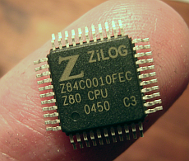
Background
This is one of the only devices we have in common
There has been support for developing on the calculator for a long time
A Z80 compiler is widely available, this is what we will use to write the applications
The TI 83 and 84 uses the Z80 processor
It runs at a screaming 6MHz
Mirage OS is very popular shell for the calculator but lacks some functionality

Slide 3
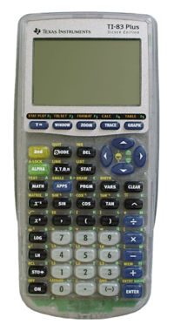
Focus Areas
TBasic
TShell
Grey-scale imaging
File Management
User Interfaces
TVim

Slide 4
TBasic
Current TI-Basic has four obvious limitations
Comments are not allowed
Custom methods or functions cannot be defined
Cannot deactivate the scrolling run indicator in the upper right
Runs very slowly because it uses higher level calculator API
Improvements to be made
Direct graphic mapping to the screen
Improvement on speed by translating API calls to equivalent native code
Comment support and better tokenizer

Slide 5
Goal
We plan to improve on features of the popular Mirage OS
Command line support
Easy file management and text editor
Improved form of TI-Basic and API
Show the power of the graphics support with an image viewer
Get better at assembly

Slide 6
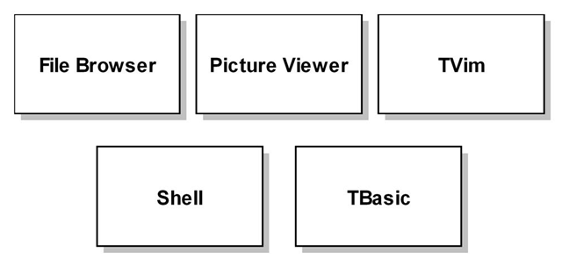
Technical Layout
Runs on top of the shell or compiled from TBasic
Compiled directly to processor code

Slide 7
Timeline
March 25
We will work in parallel to create Tbasic and a shell system
DISP statements and basic commands
Direct graphic mapping of points to create text
April 1
Basic looping and flow control
Functional shell that can launch other applications
April 8
Advanced looping and flow control
Text editor with saving and loading functions
April 15
Nested math functions in TBS
Extra capabilities to add to new API
April 22
Final release of TBS, text editor, shell, graphics converter

Slide 8
Accomplishments
TComplex
TShell
Learning low level programming
Applications of a low level OS

Slide 9
TComplex
Accomplishments
Fall backs

Slide 10
TShell
Accomplishments
It has an input interface and command recognition
Easy to use and has a lot of potential for expanding functionality
Fall backs
Execution of other programs stored on the calculator proved to be to complex
Because there was no API call to handle calling other programs, certain functionality would have to be rewritten to load the programs into memory.
Command history
Because of memory contsraints a command history would be too difficult or so memory consuming to implement

Slide 11
Fall backs
Because of the level of low level programming that needed to be done, some of the applications we would have liked to implement because too hard or impossible to implement within the scope of this class.
Greyscale imaging
File management was only partially completed
Tvim and user interface API

